Slide 1
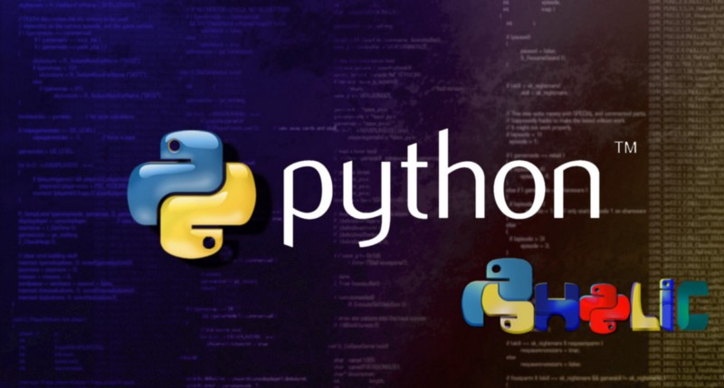

Slide 2
Python Programming & Ethical Hacking
By
Michael Davis

Slide 3
How Powerful Is Python ?
Python is such a powerful language that almost everything can be created with Python! Thats why it is used by YouTube, Instagram, Netflix!
Python is considered as the fastest-growing major programming language.
Python is easy to learn, user-friendly and powerful.

Slide 4
What Can I use Python For ?
Web Development.
Scientific computing.
Hacking
Electronics
Raspberry Pi
Robotics
Deep Learning
Machine Learning
Fingerprints identification,
Predicting stocks or spam detection.
Web Browser Automation.
Much More

Slide 5
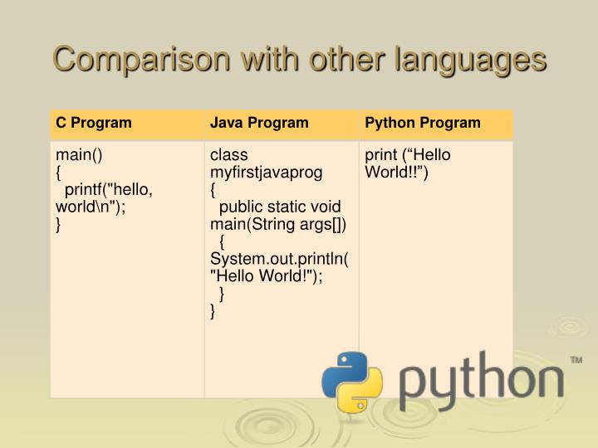
Look How Easy It Is to Code In Python !

Slide 6
Python3 Syntax Made Easy
Simple Data types
Modules & Libraries
# Comments
Variables
Strings
List & Tuples
Dictionaries
Conditional Statements
Functions
Classes
Testing
Packets

Slide 7
Modules & Libraries
In Python, a Module is a file that contains code.
Modules are used to break up large programs into smaller parts for more manageable coding.
Libraries When used in Python, a library is used loosely to describe a collection of the core modules.

Slide 8
# Comments
# Comments begin with the hash mark #
Comment is a line of text that's ignored by the Python interpreter.

Slide 9
Variables
A variable is a label for a value you want to use in your program.
Variable names in Python follow two main rules:
Variables must contain only letters, underscores, and numbers.
Variables must start with a letter or underscore.
first_name = ' Tom '
last_name = ' Henderson '
age = 35

Slide 10
Strings
A string is a value made up of one or more characters
Surrounded by single or double qoutes.
message = " I love Python ! "
print(message)
I love Python

Slide 11
List & Tuples
A list is a collection of items in a specific order
[ ] Square brackets indicate a list.
Phones = [ ‘ iPhone ’, ‘ Samsung ’, ‘ LG ’ ]
A tuple is an ordered collection of Items that cant be modified.
A tuple is indicated by parentheses ( )

Slide 12
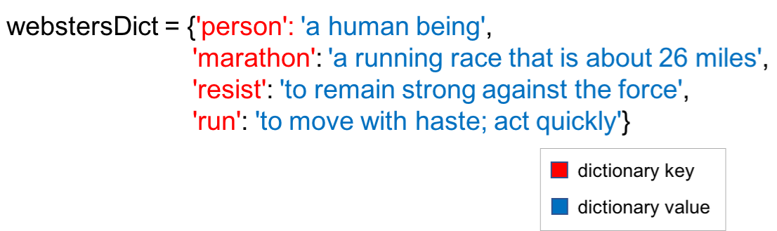
Dictionaries
{ }A dictionary is a set of Items indicated by braces
Consisting of a Key and a Value

Slide 13
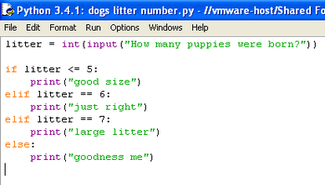
Conditional Statements

Slide 14
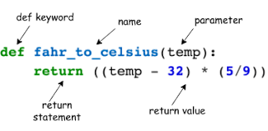
Functions
A function is a block of organized, reusable code that is used to perform a single, related action.

Slide 15
Classes & Python Object Oriented Programming
We can think of class as an sketch of a parrot with labels. It contains all the details about the name, colors, size etc
An object (instance) is an instantiation of a class. When class is defined, only the description for the object is defined. Therefore, no memory or storage is allocated.
https://www.programiz.com/python-programming/object-oriented-programming

Slide 16
MAC Address
Media Access Control
○ Permanent.
○ Physical.
○ Unique.
● Assigned by manufacturer.

Slide 17
Why change the MAC Address?
Increase anonymity.
Impersonate other devices.
Bypass filters.

Slide 18
Mac_Changer
● The subprocess module contains a number of functions. ● These functions allow us to execute system commands. ● Commands depend on the OS which executes the script.
Syntax: import subprocess
subprocess.call(“COMMAND”, Shell=True)
Using a Module To Execute System Commands

Slide 19
user input
● Easiest way of getting user input is through keyboard.
● There are a number of ways to achieve that.
● input() function prompts the user to enter a value.
Ex: age = input(“What is your age?”) Result What is your age ? The variable age will hold the value of the user input

Slide 20
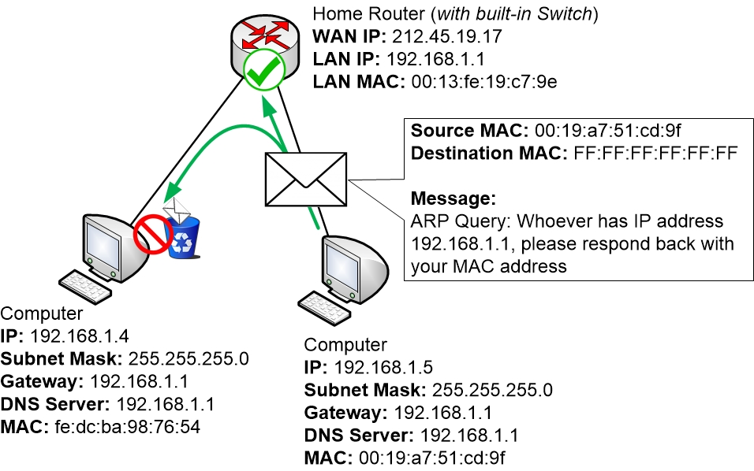

Slide 21
Keylogger
Program that records keys pressed on the keyboard.
Common features:
● Store logs locally (local keyloggers).
● Report logs to email or remote server (remote keyloggers). ● Log screenshots.
● Start with system startup.

Slide 22
Keylogger Report
Report function:
● Run in the background.
● Don’t interrupt program execution.
● Every X seconds, send report.
→ Great case for threading.

Slide 23
Classes & Object Oriented Programming
● Way of modeling program (blueprint).
● Logically group functions and data.
○ Makes code more readable.
○ More reusable.
○ Separate implementation from usage (encapsulation).
○ Easier to extend.
○ Easier to maintain.

Slide 24
Keylogger Constructor Method
● AKA initialization method.
● Gets executed automatically when a class is created.

Slide 25
Where To Find Me
github.com/81gears

